Slide 1





Framing the “Nation” :
Discourse of National Identity Construction in the Taiwan Region—An Analysis of 2024 Electoral Campaign Texts
Presenter: Zhuolin Li Nankai University
Junyu JIANGJiang Communication University of China
RC14.11
28th World Congress of Political Science

Slide 2
Research Background
National identity is not fixed. It is shaped through discourse, especially in elections.
According to Anderson (1991), the nation is an imagined community.
Political discourse plays a key role in shaping how people see the nation.In Chinese, nation is often translated as both minzu (ethnic group) and guojia (state).
This dual meaning creates ambiguity and space for political framing.
In Taiwan, this ambiguity becomes more visible due to its unique historical and social context.
Notes:
In this study, I focus on how national identity is shaped through political discourse.
We know that national identity is not something natural or fixed. Instead, it is constructed—especially during elections, where candidates present different ideas of who "we" are.
Anderson calls the nation an imagined community. This means that people feel a shared bond, not because they all know each other, but because they share symbols, stories, and values.
Political language plays a key role in building that sense of unity. It frames what to highlight and what to ignore.
In Chinese, the word "nation" can mean minzu, an ethnic group, or guojia, a political state. This creates confusion—but also opportunity.
In Taiwan, political actors often use this ambiguity to shape different visions of national identity.

Slide 3
Research Background
Research Gap :
Existing literature focuses on theoretical discussions of national identity.
Few studies examine textual patterns of framing strategies in real-world political discourse.
Even fewer use computational methods to explore how these strategies vary across actors or contexts.
Notes:
Most studies on national identity focus on theory or case-specific interpretations.
However, they rarely test whether certain discursive patterns repeat or whether framing strategies vary across time, parties, or contexts.
This gap motivates our two research questions.

Slide 4
Research Questions
RQ1: In the discursive construction of “nation” as a political signifier, is there evidence of recurrent or structurally regular framing strategies?
RQ2: To what extent are national identity framing strategies differentiated by political ideology, party affiliation, or critical sociopolitical events?
Notes:
Answering these requires both a solid theoretical framework and a systematic analysis of political texts.
We mainly focus on two research questions:

Slide 5
Theoretical Framework
Constructivist Understandings of the Nation
Anderson (1991): Nation as an imagined community, constructed through shared symbols, narratives, and language.
Gellner (1983): Nationalism precedes the nation; culture is shaped to fit political needs.
Smith (1986): Nations draw on myths, memories, and symbols from pre-modern ethnie.
Notes:
This study draws upon a set of theoretical approaches that view the nation not as a fixed entity, but as a construct shaped by discourse.
In nationalist theory, Anderson describes the nation as an imagined community, while Gellner emphasizes the role of nationalism in producing cultural uniformity.
Smith adds an ethnosymbolist dimension, linking national identity to shared ancestry and historical memory.

Slide 6
Theoretical Framework
Conceptual Ambiguity in the Chinese Linguistic Context
The term nation is translated as both minzu (ethnic group) and guojia (state).
This duality creates ambiguity → opens discursive space for political framing.
Nation as a Discursive Construct
Laclau & Mouffe (1985): Nation is a floating signifier, filled with different meanings through political discourse.
Fairclough (1992): Discourse shapes identity through framing, metaphor, and intertextual memory.
Notes:
These theories help explain how the concept of the nation is built over time, especially through symbolic and cultural mechanisms.
In the Chinese language, “nation” has dual meanings—minzu and guojia—which creates a layer of semantic ambiguity.
This ambiguity provides discursive flexibility and becomes a site of strategic contestation.
Discourse theory, especially Laclau and Mouffe’s concept of floating signifiers, shows how such ambiguous terms are given meaning through political struggle.
Fairclough’s critical discourse framework further allows us to trace how language shapes social identities through rhetorical tools.
Together, these perspectives form a coherent foundation for analyzing how political actors use language to frame and reshape national identity in electoral settings.

Slide 7
Theoretical Framework
The DPM Framework for National Identity Construction
1. Defining the National Self —— Who are we?
Asserting sovereignty and agency: Security, economic, or legal autonomy
Differentiating collective identity: Distinguishing “us” from internal/external “others”
Reinterpreting history and memory: Reframing narratives to shape shared past
Notes:
To analyze how national identity is constructed in political discourse, this study introduces the DPM Framework—a three-dimensional model that captures the rhetorical strategies used by political actors.
The first dimension, Defining the National Self, focuses on how political discourse shapes internal identity. This includes framing sovereignty, establishing cultural boundaries, and reinterpreting historical narratives to strengthen collective memory.

Slide 8
Theoretical Framework
The DPM Framework for National Identity Construction
2. Positioning the Nation Globally —— Where do we stand?
Framing external challenges: Identifying threats or strategic rivals
Shaping international status: Participation in global institutions and norms
Constructing comparative identity: Benchmarking performance, expressing aspirations
Notes:
The second dimension, Positioning the Nation Globally, looks at how actors place the nation within the international order. This involves framing external threats, asserting legitimacy through global engagement, and comparing national performance with others.

Slide 9
Theoretical Framework
The DPM Framework for National Identity Construction
3. Mobilizing the National Collective —— Where are we going?
Evoking shared emotions and values: Stories of resilience, moral unity
Fostering pride and responsibility: Civic participation and symbolic achievements
Articulating a shared vision: Collective future and national trajectory
Notes:
The third dimension, Mobilizing the National Collective, captures how discourse promotes unity and forward-looking imagination.
It includes appeals to shared emotions and values, calls for pride and responsibility, and visions of collective future.
The DPM Framework integrates insights from framing theory, constructivist theories of nationalism, and discourse theory. It allows us to go beyond surface-level content analysis and identify deeper strategic patterns in how national identity is discursively constructed.
In this study, each political text is annotated according to these dimensions, enabling both qualitative interpretation and computational classification.

Slide 10
Methodology
DeepSeek Model for Assisted Labeling
Data Sources:
Timeframe: Covered the entire 2024 Taiwanese presidential election cycle (Jan 15, 2023 - Jan 13, 2024).
Televised Campaign Speeches and Debates: All delivered within the election cycle.
Media Texts: Collected from three ideologically diverse outlets:
Liberty Times
TVBS
China Times
Twitter Posts: All tweets from the three major presidential candidates during the election cycle.
Task: Determined dual labels for each text.
Label 1: Political Semantic Framework
Label 2: National Identity Construction Connotation
Method: Used a prompt with:
Task instructions
Label schema details
135 Few-shot examples by manual label for learning.
prompt (in chinese):
[Label 1: Political Semantic Framework] {label1_guide}
[Label 2: National Identity Construction Connotation] {label2_guide}
Please refer to the following few-shot examples: {few_shot_examples}
Now, please determine the labels for the following text: "{text}"
Please return only in the following format: Label 1: xxx Label 2: xxxb.
Notes:
This study uses a dual-label annotation approach to analyze political discourse during Taiwan’s 2024 presidential election.
The dataset covers a full election cycle—from January 15th, 2023, to January 13th, 2024—and includes four types of sources: – televised campaign speeches, – televised debates, – media texts from Liberty Times, TVBS, and China Times, – and all tweets from the three major presidential candidates.
For each text unit, we applied a dual-labeling strategy using the DeepSeek large language model.
The first label identifies the Political Semantic Framework, such as security, morality, or economy.
The second label captures the National Identity Construction Connotation, such as claims to sovereignty, emotional mobilization, or international positioning.
The policy-oriented label system builds on the Policy Frames Codebook (Boydstun et al., 2013), extended by McConnell (2020) and enriched with narrative framing theory (Iyengar, 1991).
To guide the model, we designed a detailed prompt. This included the labeling schema, task instructions, and sample format.
Importantly, we adopted a few-shot learning approach, providing 135 manually labeled examples.
These examples helped DeepSeek learn the patterns of both semantic framing and identity-building strategies before labeling the rest of the dataset.
This method balances accuracy and scalability. It allows us to apply fine-grained discourse analysis across a large volume of political texts with consistent labeling logic.
-----------
Dual-Labeling: Emphasize that DeepSeek was designed to assign two labels simultaneously, capturing different aspects of the political discourse.
Specific Label Categories: Highlight the names of the two label categories: "Political Semantic Framework" and "National Identity Construction Connotation." These define the specific analytical focus.
Prompt Engineering: The use of a prompt is crucial. Mention that it included detailed instructions and the label schema to guide the model.
Few-Shot Learning: The significant number of 135 few-shot examples is a key detail. This demonstrates that the model was provided with a substantial amount of manually labeled data to learn the nuances of the task before being used for assisted labeling of the rest of the dataset. It highlights the effort in preparing the examples and suggests that DeepSeek benefited from this targeted learning.

Slide 11
The DPM Framework for National Identity Construction
Political Semantic Framework | Economic Factors | Encompasses issues related to resources, capabilities, market influence, and distribution.
 | Morality and Ethics | Addresses public opinion dynamics and potential political consequences.
 | Conflict and Security | Covers matters of social tensions, crime, public safety, and national security.
 | Human Interest and Well-being | Focuses on quality of life, health and safety, and cultural identity.
 | Fairness, Equality, and Justice | Includes concerns about social justice, legal rights, and jurisdictional fairness.
 | Legality and Governance | Encompasses constitutional principles, rule of law, and judicial authority.
 | Public Sentiment and Political Implications | Addresses public opinion dynamics and potential political consequences.
 | Policy Formulation and Evaluation | Involves policy design, implementation effectiveness, external oversight, and foreign policy considerations.
National Identity Construction Framework | Articulating Shared Vision | Projects an aspirational future to inspire hope and unity.
 | Awakening Public Responsibility | Reinforces members' sense of duty and responsibility toward the collective.
 | Calling for Unity | Appeals to collective determination and belief in joint action.
 | Constructing Collective Memory | Builds a shared memory base to foster emotional attachment and group identity.
 | Constructing Common Crisis | Emphasizes universal and collective threats to generate cohesion.
 | Differentiating Collective Identity | Highlights the distinction between the in-group and the "Other."
 | Evoking National Pride | Invokes national honor, achievements, or symbols to elicit positive identification.
 | Fostering Comparative and Competitive Awareness | Frames identity through contrast with external reference groups to stimulate internal mobilization.
 | Mobilizing Shared Emotions | Activates group emotions to create strong emotional bonds.
 | Nation Symbols Full of Metaphors | Imbues national identity with symbolic representations to strengthen individual identification.
 | Reinterpreting Historical Narratives | Reinterprets history to establish a sense of historical continuity within the national community.
 | Setting Common Enemy | Creates external antagonism to foster internal unity.
 | Shaping International Legitimacy | Seeks external recognition by embedding identity within internationally accepted frameworks.
Notes:
This is the specific The DPM Framework, which had been adopted in NLP Model for annotation and label.

Slide 12
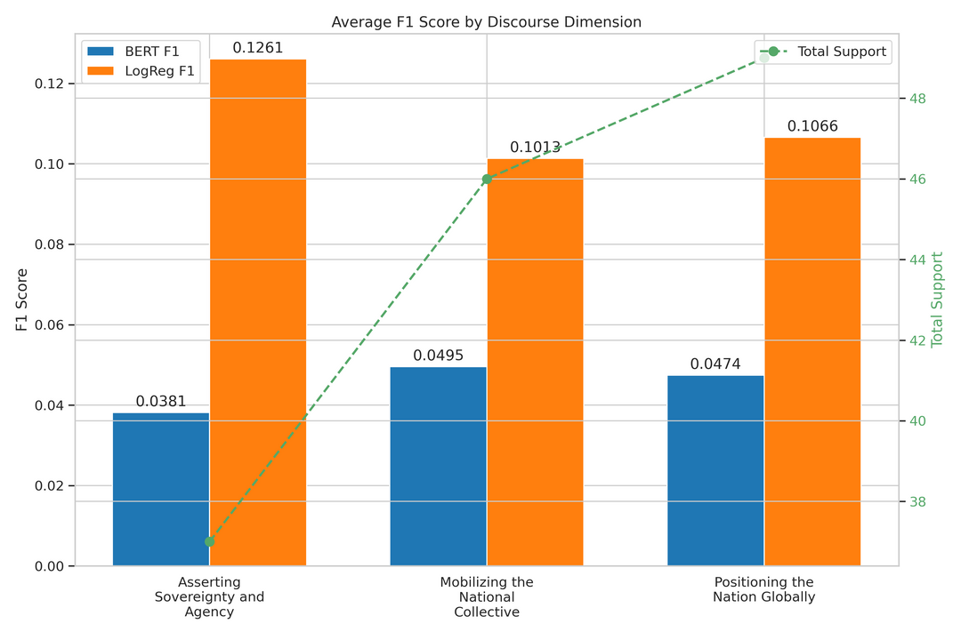
DeepSeek Model Outperforms BERT for Political Discourse Classification
We developed and evaluated a locally deployed pre-trained language model for classifying Taiwanese political discourse.
METHODOLOGY: Supervised fine-tuning and evaluation of a BERT model and a DeepSeek model on a manually annotated dataset of 135 text entries across 21 political discourse categories.
BERT Limitations:
Showed stable fitting but a generalization bottleneck ——validation accuracy≈33%.
Significant "support penalty" (F1-scores below 0.05).
DeepSeek Superiority:
a positive correlation between support and F1-score.
multiplicative superiority over BERT in key frameworks
Excelled in semantically complex frameworks related to national identity construction.
Notes:
In this study, we compared two models to classify Taiwanese political discourse: a conventional BERT model, and the newer DeepSeek model.
Both models were tested on a manually annotated dataset with 21 discourse categories.
While BERT performed well in training, it struggled to generalize—its validation accuracy stayed low, around 33%.
It also had trouble with categories that appeared less often, and failed to capture symbolic or emotional content.
In contrast, DeepSeek performed much better on complex and infrequent categories.
It showed stronger F1-scores in key areas like sovereignty claims, national positioning, and collective mobilization.
For this reason, we chose DeepSeek for the main labeling task. It was more effective for capturing the subtle and strategic patterns in national identity discourse.
---
Objective: To classify Taiwanese political discourse using local language models.
Models: Compared BERT (conventional) and DeepSeek (advanced).
Data: Manually annotated dataset with 21 categories.
BERT Findings:
Generalization issues (low validation accuracy).
Struggled with frequent categories ("support penalty").
Poor performance in emotionally symbolic topics.
DeepSeek Findings:
Better generalization, especially for imbalanced data.
Significantly outperformed BERT in crucial political discourse areas (Sovereignty, National Positioning, Mobilization).
Strong in complex semantic categories of national identity.
Key Insight: DeepSeek is more effective for nuanced and less frequent political discourse topics compared to standard BERT.

Slide 13
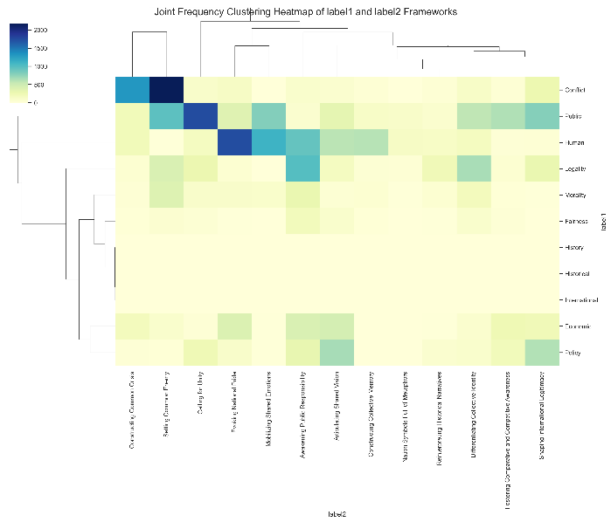
Latent Structures and Discursive Priorities in National Identity Framing
Conflict frames are strongly aligned with "Setting Common Enemy" and "Constructing Common Crisis", revealing a strategy of identity through opposition — the nation is framed by what it stands against (D: Defining the National Self).
Human interest frames co-occur with "Mobilizing Shared Emotions" and "Evoking National Pride", highlighting an affective discourse that constructs the nation as an emotional community (M: Mobilizing the Collective).
Economic and Legality frames are frequently paired with "Fostering Comparative Awareness" and "Shaping International Legitimacy", reflecting a technocratic vision of nationhood grounded in performance and global status (P: Positioning the Nation Globally).
Public and Policy frames favor "Awakening Public Responsibility" and "Articulating Shared Vision", emphasizing civic responsibility and future-oriented mobilization (M: Mobilizing the Collective).
Notes:
We find that conflict frames often appear with meanings like “setting a common enemy” or “building a shared crisis.” This shows how political discourse defines the nation by contrast — through opposition. It reflects the “Defining the National Self” part of our DPM framework.
Next, human interest frames often go with meanings like “national pride” and “shared emotions.” These build the nation as a community of feeling and memory. This fits the “Mobilizing the Collective” dimension.
We also see that economic and legality frames link to global position and comparative strength. Here, the nation is shown as a capable actor in international settings. This relates to “Positioning the Nation Globally.”
Finally, policy and public frames highlight responsibility and shared goals. They promote civic duty and collective direction.
Overall, these patterns suggest that national identity is shaped through different discursive strategies — not fixed, but constructed in context.

Slide 14
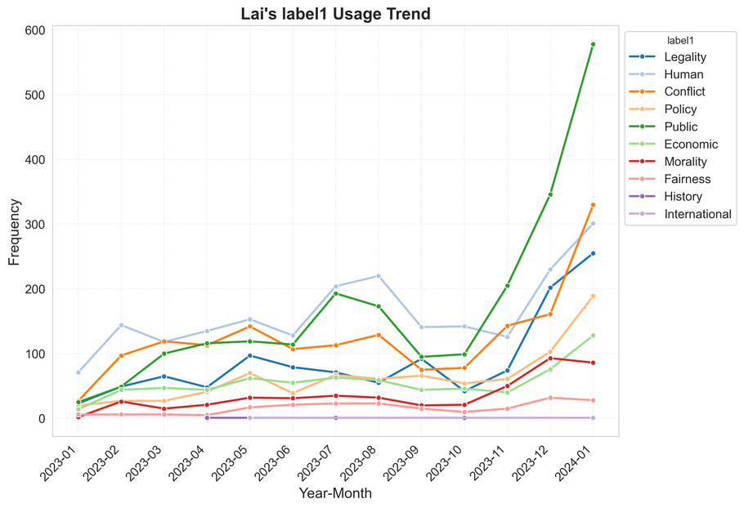
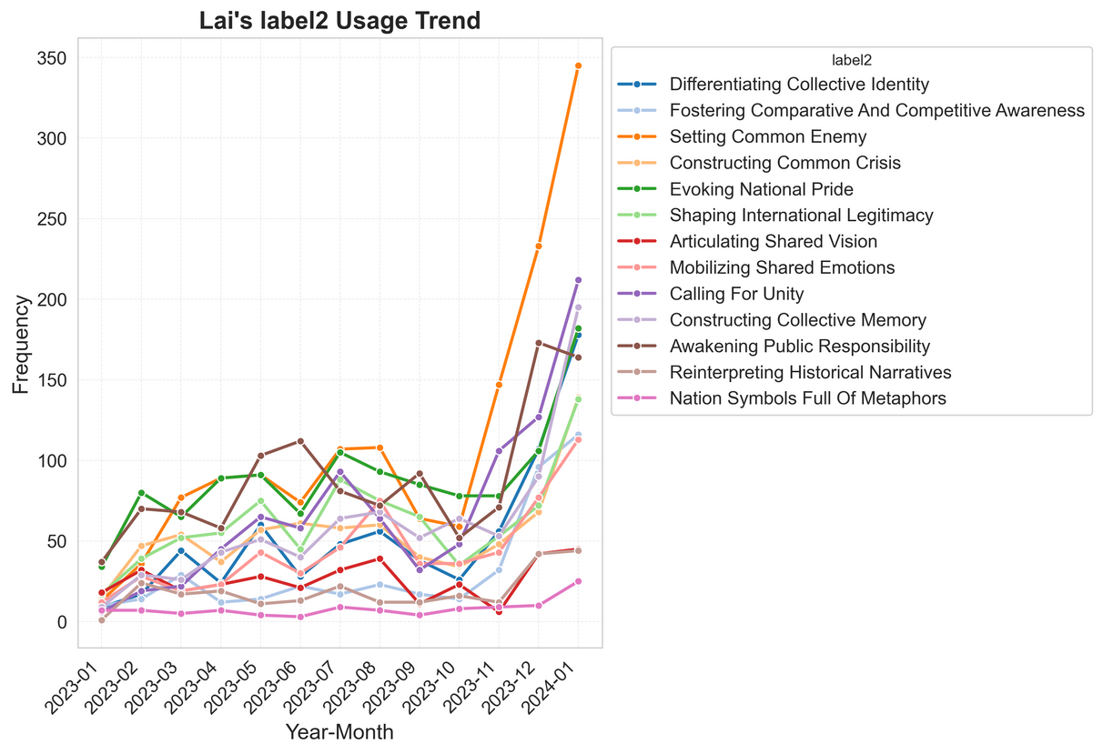
Divergent Framing Strategies among Candidates
Lai Ching-te - National Sovereignty and High-Intensity Mobilization
Early: Identity & Governance via national pride, legitimacy, common foes. Focused on Public, Economic, Policy. Defined national self, positioned Taiwan globally.
Mid: Aggressive Mobilization & Victimhood. Intensified Differentiated Identity, Comparative Competence, Emotional Solidarity. Emotional appeals, fostered collective loyalty.
Final: Explosive Mobilization & Leadership. Maximized support, reiterated national identity/threat, presented as resolute leader. Integrated all DPM dimensions.
Notes:
We did specific analysis of the framings used by three Candidates:LAI\KE\HO, and conducted the usage trend of the them.
Lai Ching-te used frames emphasizing national sovereignty and external threats to project authority and mobilize support for his vision of the nation.

Slide 15
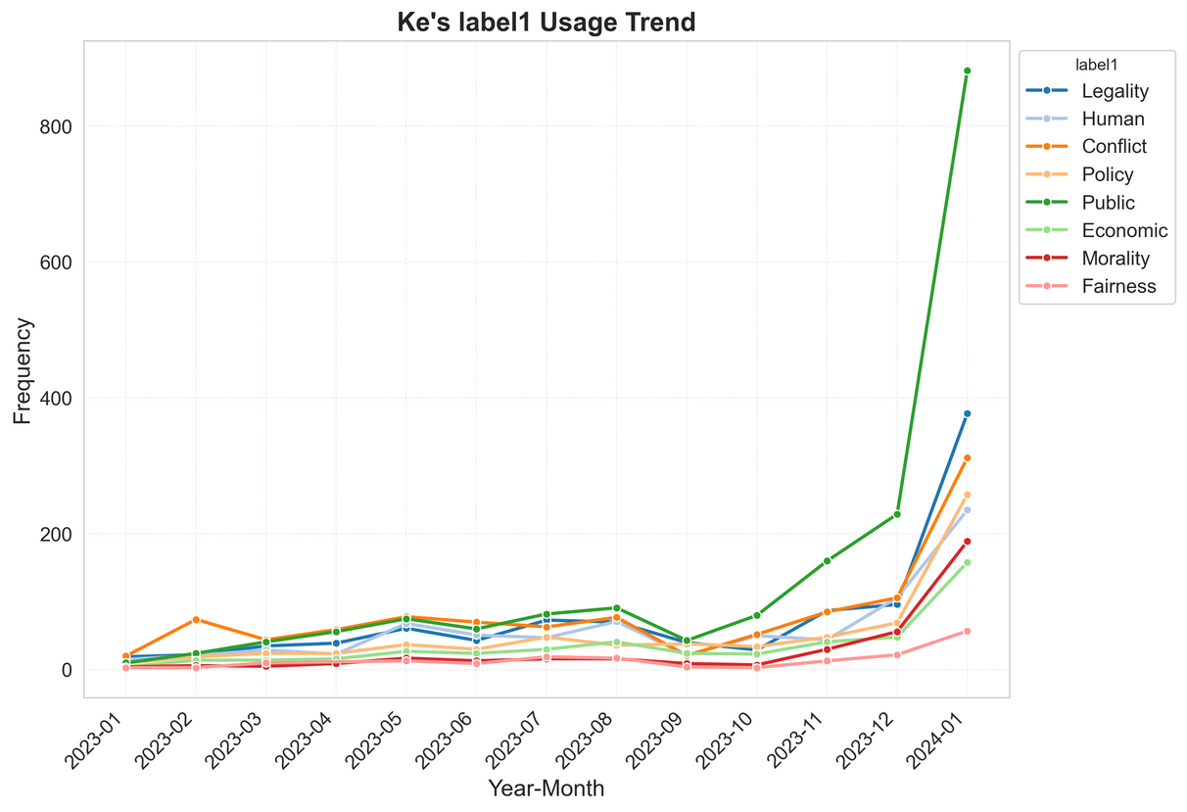
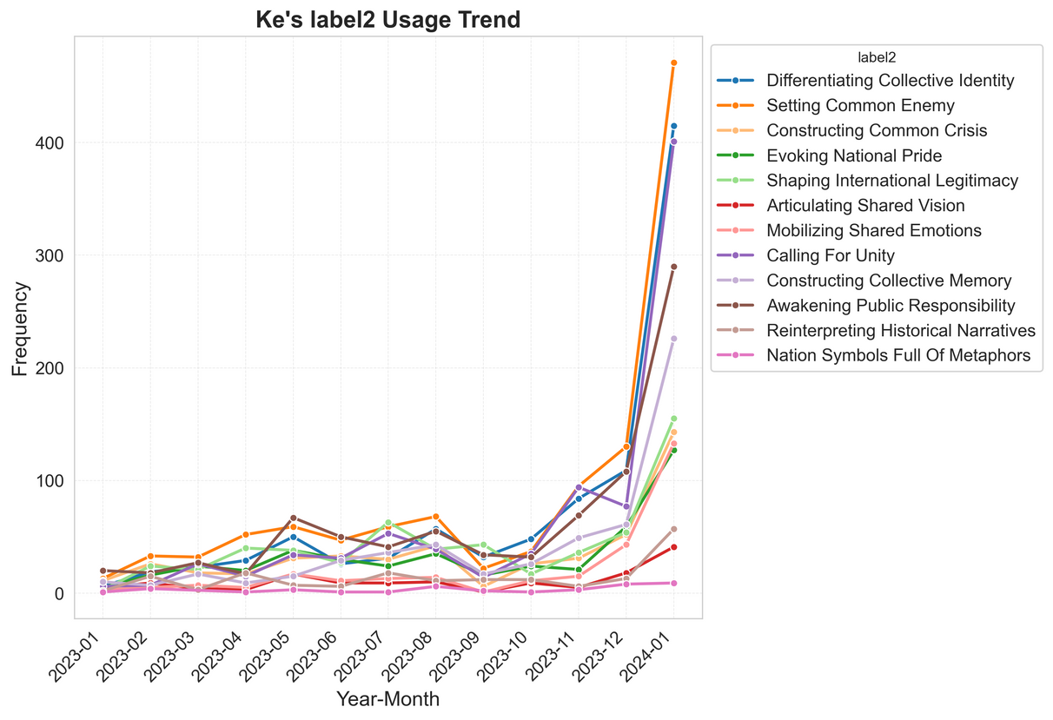
Divergent Framing Strategies among Candidates
Ko Wen-je - Centrist & Adaptive Framing
Early: Low-Key Differentiation. Subdued framing, strategic silence to appear as reformer. Defined self by nonconformity.
Mid: Gradual Engagement & Competency. Increased focus on international legitimacy & emotional mobilization. Aimed to build image of competent innovator.
Late: Emotional Resonance & Unity. Intensified shared emotional mobilization & international legitimacy. Used enemy construction to unify. Asserted inclusive, reformist national self.
Notes:
Ko Wen-je strategically employed frames centered on transformation and inclusivity to challenge the status quo and offer an alternative national identity.

Slide 16
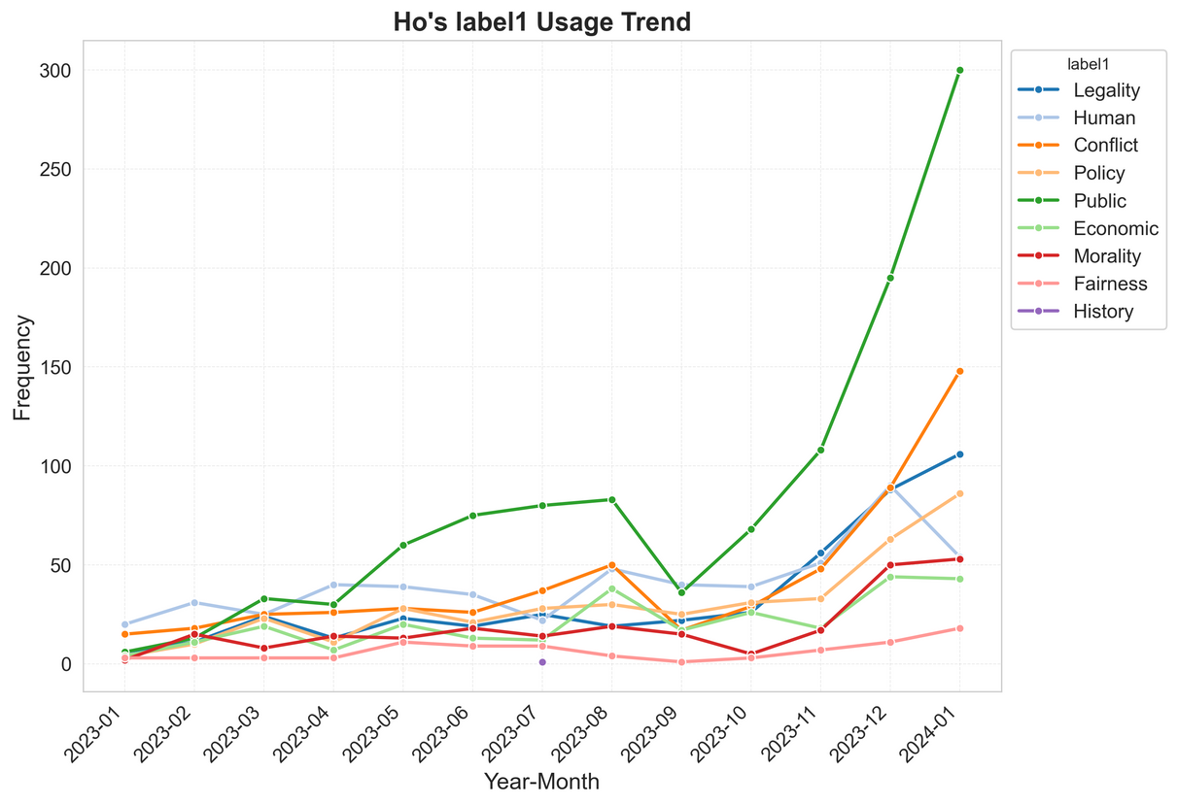
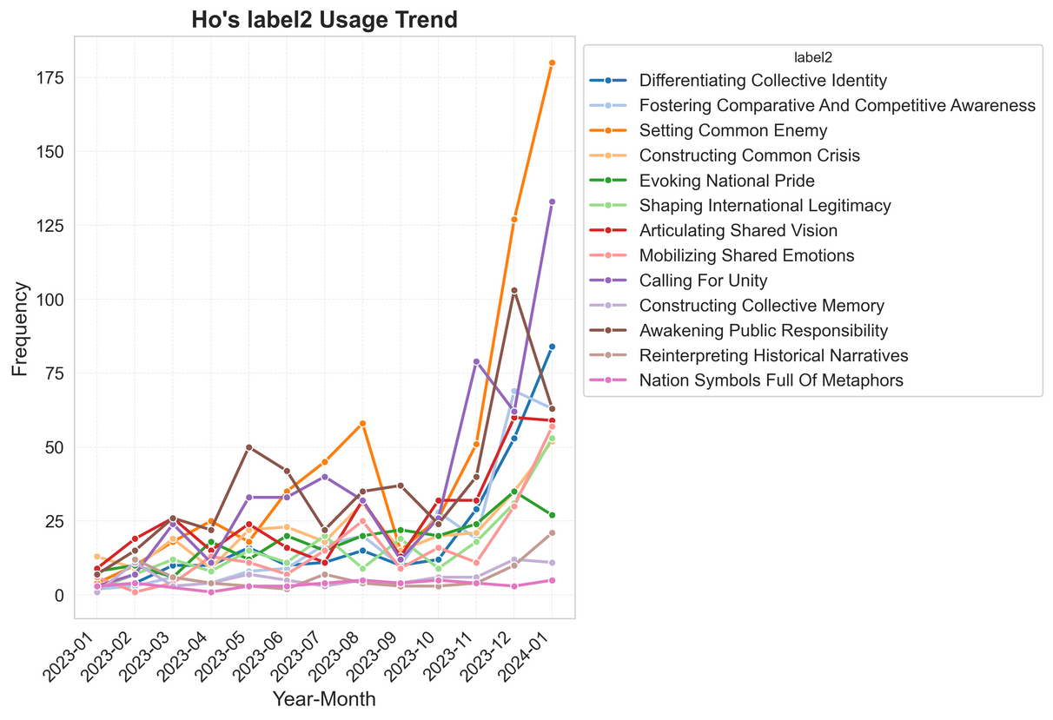
Divergent Framing Strategies among Candidates
Hou You-ih - Pragmatic Governance & Livelihood
Early: Low-Profile Pragmatism. Minimal framing, prioritized local governance & practical outcomes. Low use of Public, Economic, Policy. Defined self by problem-solving.
Mid: Gradual Uptick & Issue Focus. Increased use of comparative awareness & emotional mobilization. Growing focus on "public" issues.
Late: Public-Centric Catch-Up. Dramatic increase in various frames, especially "public." Focused on collective concerns & public welfare to align with everyday interests.
Notes:
Hou You-ih focused his framing on pragmatic governance and people's livelihood to position himself as a stable problem-solver aligned with public interests.

Slide 17
Findings
National Identity:
Not a static entity, but a dynamic field of meaning actively constructed through political communication.
Key Framing Strategies:
Conflict Frame
e.g.
2. Human Interest Frame
3. Economic/Legitimacy Frame
中共領導人習近平統治下是「紅大於專」，意識形態勝過專業，嚴重災害起於人禍，災害發生後，中共忙著卸責、掩蓋真相。
Under the leadership of Xi Jinping, the Chinese Communist Party (CCP) has prioritized ideological loyalty over professional expertise — a trend described as “red outweighing expert.” In several major disasters, human error has played a significant role, and in their aftermath, authorities have often been accused of shifting blame and covering up the truth.(Conflict , Setting Common Enemy)
馬英九在祭拜完後受訪，他情緒激動幾度拭淚，他哽咽表示，慎終追遠是中國人道德教育非常重要的一部分，
After paying his respects at the memorial, Ma Ying-jeou became visibly emotional and was seen wiping away tears several times during the interview. Choking up, he stated that "honoring the deceased and remembering our ancestors is a deeply important part of moral education for Chinese people.“ (Morality, Constructing Collective Memory )
但是，蔡英文的執政團隊認真做事，也懂得反省，我們總是快速調整、找出方法、扛住壓力、解決問題，來因應國際情勢的變局，回應民意的期待。
However, President Tsai Ing-wen’s administration works diligently and knows how to reflect on its actions. We are always quick to adapt, find solutions, endure pressure, and tackle problems head-on to respond to the changing international landscape and meet the expectations of the public. (Legality, Evoking National Pride )
Notes:
We’ve identified three key framing strategies used to construct national identity, and also we illustrate some examples above.
The first one is the Conflict Frame. This strategy emphasizes a sense of "us versus them" by identifying a common enemy or constructing a shared crisis. It helps build national unity by creating external pressure — basically, bringing people together through a perceived threat.
Next is the Human Interest Frame. This one works through emotion. It taps into shared feelings — like national pride, collective struggles, or cultural identity. It portrays the nation as an emotional community, where people feel connected through stories, symbols, and shared values.
Finally, we have the Economic or Legitimacy Frame. This frame focuses on positioning the nation in a global context — showing how it competes, progresses, and gains international recognition. It highlights institutional strength, development, and foreign approval, helping people feel proud of their country’s global role.

Slide 18
Findings
Pragmatic and Civic Turn of strategy:
National identity discourse has shifted away from purely ethno-symbolic or historical foundations toward more civic-oriented, pragmatic, and emotionally resonant understandings.
Dominant Themes:
awaken public responsibility/articulate a shared vision
Marginalized Themes:
metaphoric national symbols/collective memory construction
Persistent Logic of Antagonism:
shared crisis construction/common enemy designation
成果展示
Notes:
First, the dominant themes — people most often call to “awaken public responsibility” and “articulate a shared vision.” These are all about looking forward and encouraging everyone to get involved and take action.
Then, there are some themes that come up much less — like “metaphoric national symbols” and “building collective memory.” This tells us that there’s less focus on deep cultural traditions and historical roots of China in the current conversations.
But one thing that stays pretty consistent is the idea of “shared crises” and “common enemies.” This means that national identity is still shaped not just by who “we” are, but also by who “we” are against.

Slide 19
Findinsgs
Impacts on Public Understanding
Constructing a “Us–Them" Dichotomy:
defining "Taiwanese identity" in opposition to external threats or in terms of internal unity, political discourse delineates group boundaries and fosters collective belonging.
Policy Legitimation and Agenda Shaping
"Taiwanese identity" is strategically linked to key policy priorities—such as national security and economic development—thus legitimizing political action and influencing the public agenda.
Reimagining the Nation and Civic Belonging
Through continuous discursive reframing, "Taiwanese identity" is redefined to incorporate new meanings related to sovereignty, civic participation, and shared aspirations.
Strategic Negotiation of Identity
"Taiwanese identity" functions as a contested and negotiated field, shaped by partisan interests, electoral strategies, and competing visions of collective self-understanding.
Notes:
First, there’s the construction of a clear “Us-Them” divide. “Taiwanese identity” is often defined in opposition to outside threats or in terms of uniting people inside the group. This kind of political talk draws clear group boundaries and helps people feel they belong together.
Second, identity gets linked to important policy issues like national security and economic growth. By doing this, politicians legitimize their actions and shape what the public focuses on.
Third, we found that the idea of “Taiwanese identity” isn’t fixed — it’s constantly being reimagined. Through ongoing discussions, it gains new meanings related to sovereignty, citizen participation, and shared hopes for the future.
Finally, “Taiwanese identity” isn’t just a given; it’s something people actively negotiate. Different political parties, election strategies, and visions all compete to define what it really means to be Taiwanese.

Slide 20
Questions & Answers
Junyu Jiang Email: juj013@ucsd.edu
Zhuolin Li Email:
RC14.11
28th World Congress of Political Science

